Slide 1
Software Engineering UML definition
Dan CHIOREAN
Babeş-Bolyai University
chiorean@cs.ubbcluj.ro

Slide 2
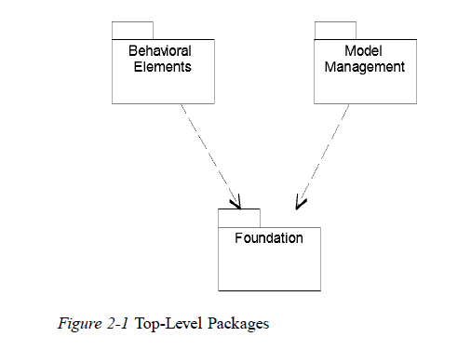
UML_definition – Top Level Packages
Language definition (1.4.1)
concrete syntax
abstract syntax (metamodel + constraints)
semantics

Slide 3
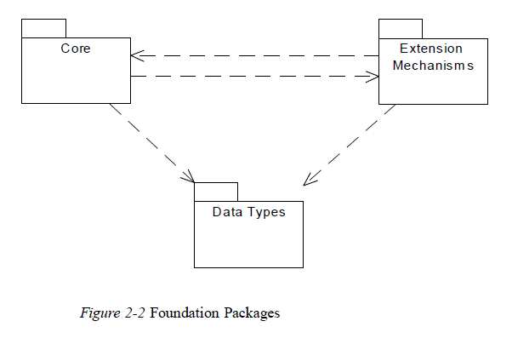
UML_definition – Fundation Packages

Slide 4
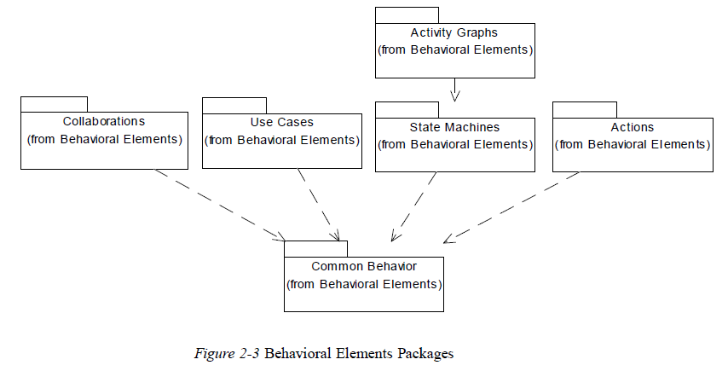
UML_definition – Behavioral Elements Packages

Slide 5
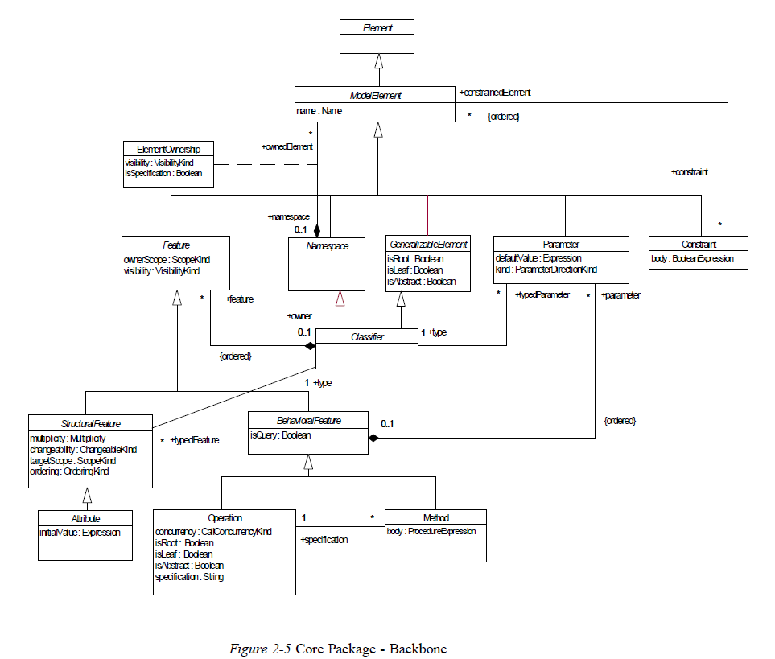
UML definition – Core Package - Backbone

Slide 6
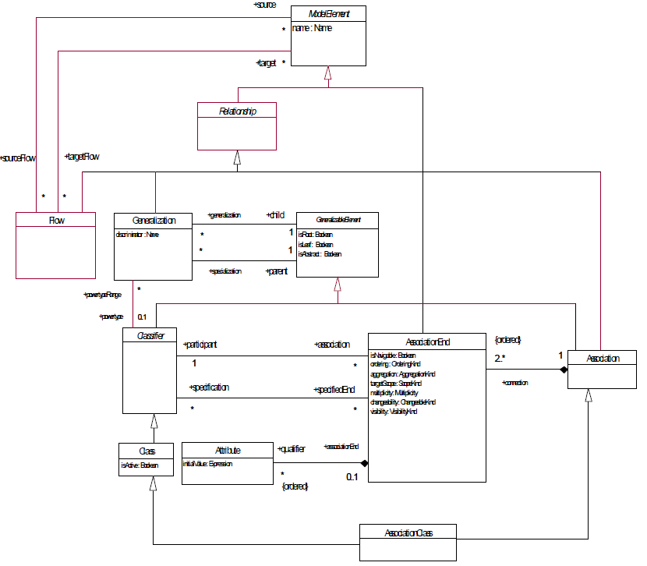
UML definition – Core Package - Relationships

Slide 7

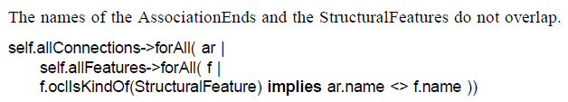
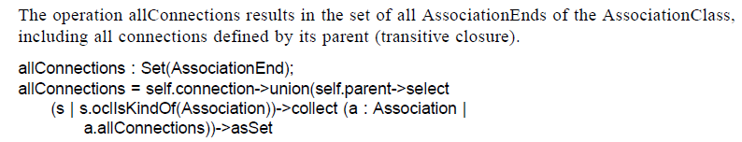
UML definition – Fundation WFRs & AOs

Slide 8
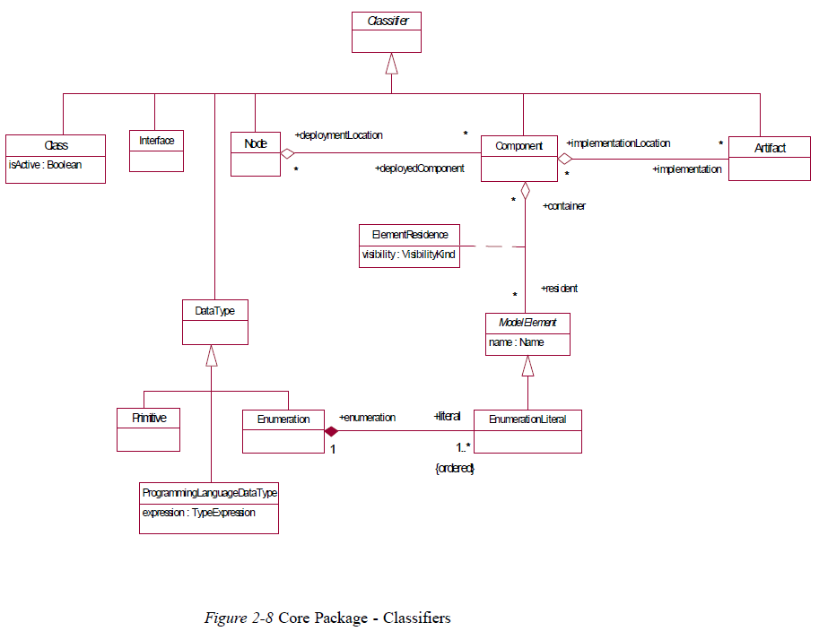
UML definition – Core Package - Classifiers

Slide 9
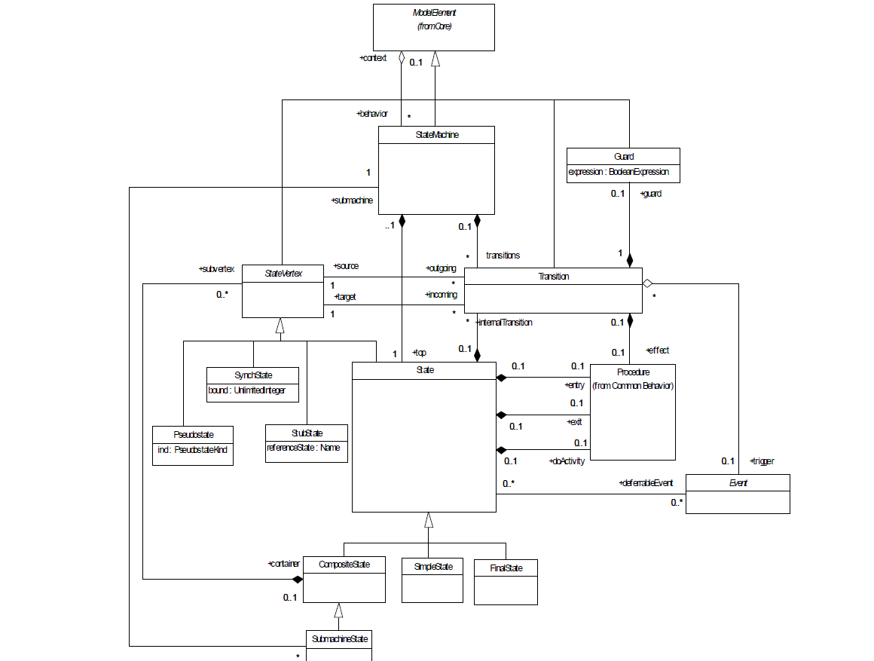
UML definition – State Machines - Main

Slide 10
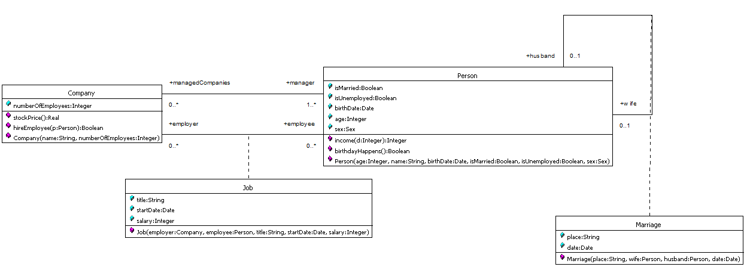
UML model – Instances of Fundation (meta)classes

Slide 11
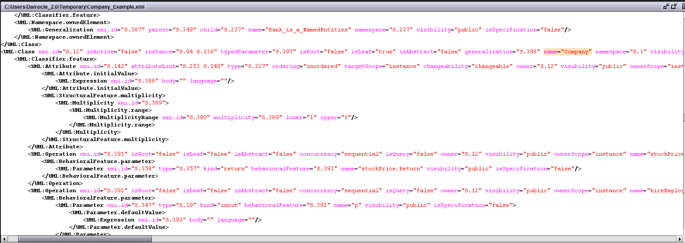
Managing UML models persistency – XMI files

Slide 12
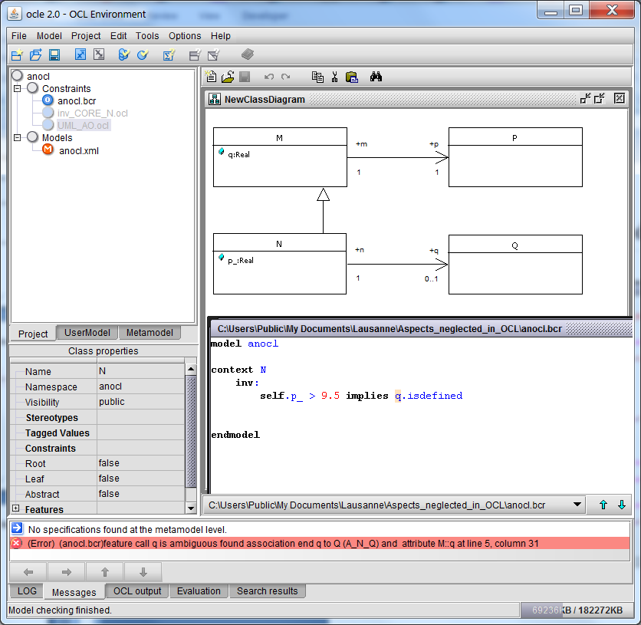
Example of Ambiguous UML Model

Slide 13
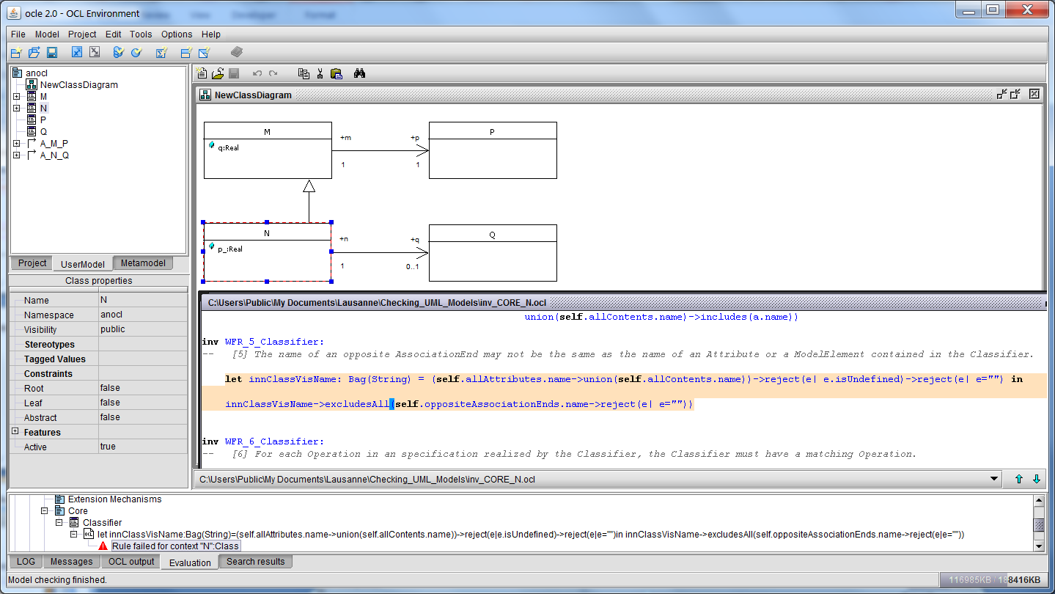
Checking Ambiguities in UML Models

Slide 14
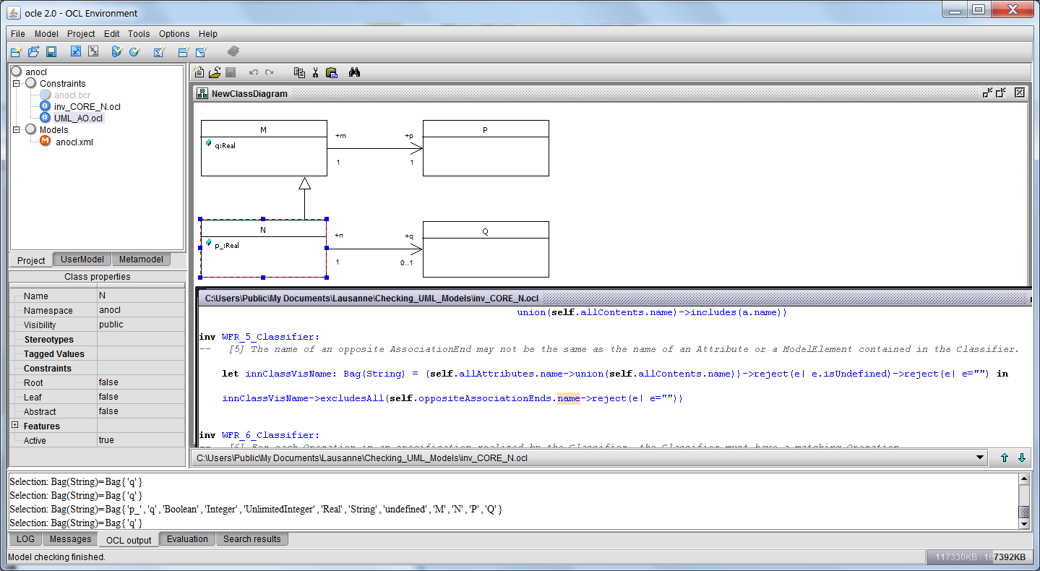
Checking Ambiguities in UML Models

Slide 15
Thanks for your patience!

